Slide 1
CS 310 Operating Systems Lecture 23 Scheduling – Basics
Ravi Mittal
IIT Goa

Slide 2
Acknowledgements !
Contents of the class -presentation have been taken from various sources. Thanks are due to the original content creators:
CS162, Operating System and Systems Programming, University of California, Berkeley
Book: Modern Operating Systems, Andrew Tenenbaum, and Herbert Bos, 4th Edition, Pearson
Book: Operating System: Three Easy Pieces, by Remzi H Arpaci-Dusseau, Andrea C Arpaci-Dusseau, Chapter 7, CPU Scheduling

Slide 3
Reading
Book: Modern Operating Systems, Andrew Tenenbaum, and Herbert Bos, 4th Edition, Pearson
Chapter 2
Book: Operating System: Three Easy Pieces, by Remzi H Arpaci-Dusseau, Andrea C Arpaci-Dusseau, Chapter 7, CPU Scheduling
https://pages.cs.wisc.edu/~remzi/OSTEP/cpu-sched.pdf

Slide 4
In this lecture we will study
Basic Concepts
Categories of Scheduling Algorithms

Slide 5
Basic Concepts

Slide 6
Scheduling: All About Queues

Slide 7
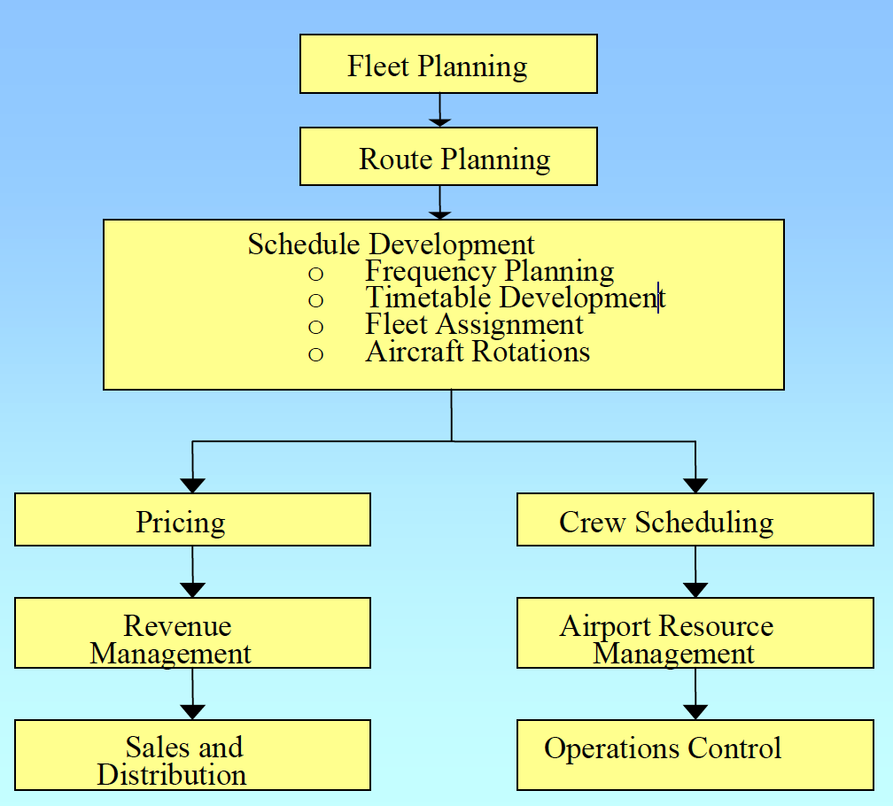
Airline scheduling
Given a set of routes to be operated in an airline network, and a fleet of aircraft, schedule development involves
Frequency planning (how often?)
Timetable development (at what times?)
Fleet assignment (what type of aircraft?)
Aircraft rotation planning (network balance)
Complex ?

Slide 8
Airport Scheduling - Complexity

Slide 9
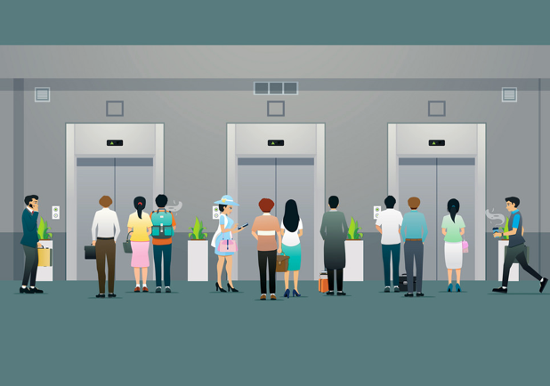
Lift scheduling

Slide 10
Lift Scheduling
Parameters
Average waiting time for users
Lift utilization
Power consumption
Priority at certain floors
Lift speeds – Uniform vs variable

Slide 11
Real-life – Scheduling

Slide 12
Scheduling is important activity
PCs, Laptops
Batch Servers
Time Sharing Systems
Networked Servers
Mobile Devices
Many other devices

Slide 13
Scheduling in PCs, Laptops
Only one user
Less important if user runs only one or two applications
It becomes important if users runs multiple applications concurrently
Video Games
Music
Browsing
Etc
With virtualized PC, there is a large number of processes running at any time
Scheduling becomes important
Adapted from: Tanenbaum, Modern Operating Systems

Slide 14
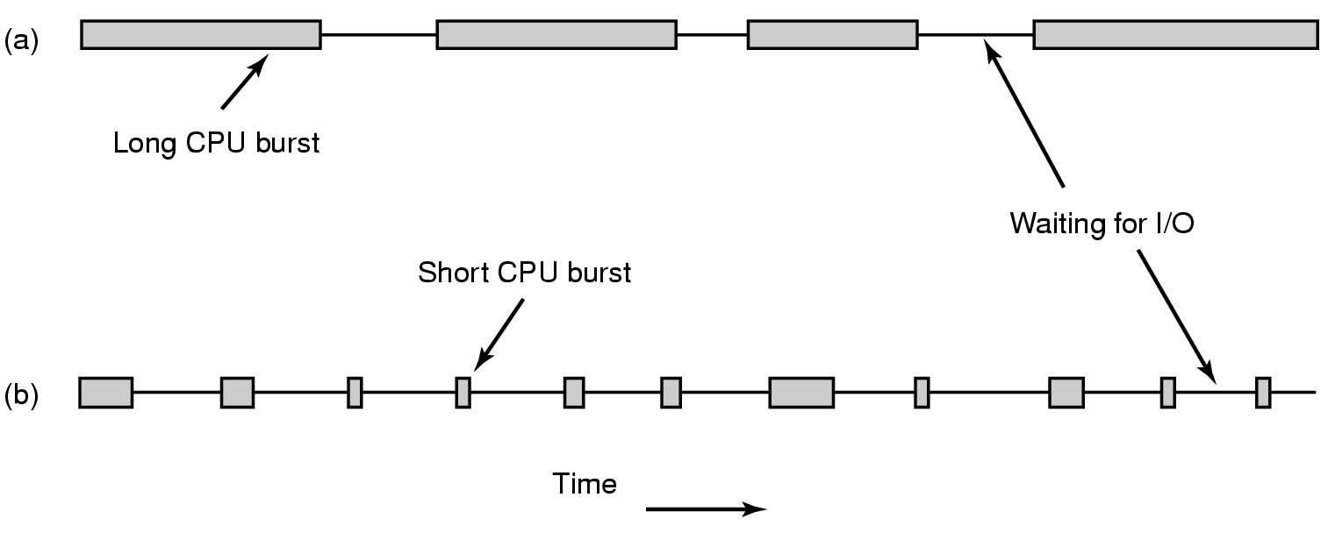
CPU Bursts
CPU-bound process
I/O-bound proces
As processors become faster, processes tend to become more I/O bound
Why?
CPU is becoming faster than the I/O
Adapted from: Tanenbaum, Modern Operating Systems

Slide 15
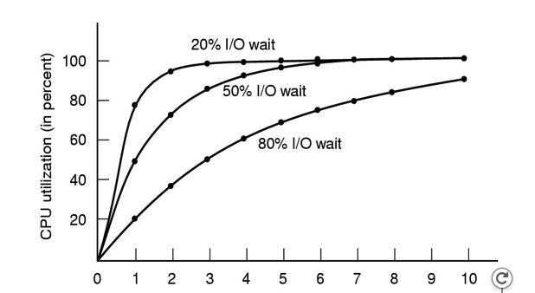
I/O bound processes vs Utilization
Degree of Multiprogramming
I/O bound process must get a chance to run quickly
So that it can issue I/O request early → keep disk busy
When processes are I/O bound, it takes more number of processes to keep CPU fully occupied
Adapted from: Tanenbaum, Modern Operating Systems

Slide 16
When to make scheduling decisions?
When a new process is created
Run a parent process or a child process as both processes are in ready state
When a process exits
Which process from the ready list is chosen to run?
When process blocks for I/O
On a condition variable or semaphore, or for some reason for blocking
Does scheduler know this dependency ? Eg Process A has made wait() system call
I/O interrupt occurs
Which process to run next? Process that made I/O request or existing ready process or newly created process

Slide 17
When to make scheduling decisions? (continued)
Timer Interrupt
OS gets control and scheduler can decide which process to run

Slide 18
Non-preemptive vs Preemptive scheduling
Non-preemptive Scheduling Algorithm
Picks up a process to run
Let the process run until it blocks (for I/O or waiting for another process) or voluntarily releases the CPU
A process may run for hours; it will not be forcibly suspended
No scheduling decisions are made during clock interrupts
Preemptive Scheduling
Picks up a process to run
lets the process run for a maximum of some fixed time
At the end of time period, timer interrupt occurs
In Kernel mode, scheduler picks up another ready process to run

Slide 19
Categories of Scheduling Algorithms

Slide 20
Scheduling Algorithms - types
Different environment require different scheduling algorithms
Different applications have different goals → requires appropriate scheduling algorithms
Categories of Scheduling Algorithms
Batch
Interactive
Real time (deadlines)

Slide 21
Batch Systems
Still in widespread use
Example: Payroll, Inventory, Accounts receivable, Accounts payable, interest calculation (at banks), Claim processing (insurance) etc
periodic tasks
No users impatiently waiting at their terminals for a quick response to a short request
Non-preemptive algorithms, or preemptive algorithms with long time periods for each process
Less context switches → improved performance
Adapted from: Tanenbaum, Modern Operating Systems

Slide 22
Batch System

Slide 23
Interactive Systems
Preemption is necessary in interactive systems
Otherwise one process may hog the CPU
Program bug may cause it to run indefinitely
Servers also need preemption
Adapted from: Tanenbaum, Modern Operating Systems

Slide 24
Real-time system
What is a real-time system?
Deadline
Hard
Soft
Deadlines must be met
Real-time OS (RTOS) ?
Predictability is important
Example: Audio processing vs video processing
How about Linux and Windows ?
Are they RTOS ?

Slide 25
In a modern multicore processor
Processor Scheduling
Bus scheduling
Network Scheduling
I/O scheduling

Slide 26
Role of Dispatcher vs. Scheduler
Dispatcher
Low-level mechanism
Responsibility: context switch
Save previous process state in PCB
Load next process state from PCB to registers
Change scheduling state of process (running, ready, or blocked)
Migrate processes between different scheduling queues
Switch from kernel to user mode
Scheduler
High-level policy
Responsibility: Deciding which process/thread to run

Slide 27
Scheduling Policy Goals/Criteria
Minimize Response Time
Response time: Time between issuing a command and getting result
Maximize Throughput
Maximize operations (or jobs) per second
Minimize Turnaround time
Average elapsed time
primarily for batch system
Fairness
Share CPU among users in some equitable way
Kubiatowicz CS162 © UCB Fall 2020

Slide 28
Scheduling Policy Goal: Minimize Response Time
The time between issuing a command and getting the result
Response time is what the user sees:
Time to echo a keystroke in editor
Time to compile a program
Real-time Tasks: Must meet deadlines imposed by World
Important for interactive systems
Example: in PCs, there are many background processes. A user request (to open a file) must be given priority over background processes
Response time – User perception plays a big role
Kubiatowicz CS162 © UCB Fall 2020

Slide 29
Scheduling Policy Goal: Maximize Throughput
Maximize operations (or jobs) per second
Two parts to maximizing throughput
Minimize overhead (for example, context-switching)
Efficient use of resources (CPU, disk, memory, etc)
Kubiatowicz CS162 © UCB Fall 2020

Slide 30
Scheduling Policy Goal: Turnaround time
The turnaround time of a job
The time job completes minus the time at which the job arrived in the system
T_{turnaround} = T_{completion} - T_{arrival}
It measures how long the average user has to wait for the output
A scheduling algorithm may try to optimize turnaround time and throughput
Higher throughput doesn’t mean minimizing turnaround time
Example: A scheduler that always ran short jobs and never ran long jobs
Excellent throughput but terrible turnaround time for the long jobs
Kubiatowicz CS162 © UCB Fall 2020

Slide 31
Scheduling Policy Goal: Fairness
Share CPU among users in some equitable way
Fairness is not minimizing average response time
Performance and fairness are often at odds in scheduling
Scheduler may optimize performance but at the cost of preventing a few jobs from running,
decreasing fairness
Kubiatowicz CS162 © UCB Fall 2020

Slide 32
Useful metrics
Waiting time for process P: time before P got scheduled
Average waiting time: Average of all processes’ wait time.
Completion time: Waiting time + Run time.
Average completion time: Average of all processes' completion time
Kubiatowicz CS162 © UCB Fall 2020

Slide 33
Lecture Summary
Scheduling is very important function of all Operating Systems
As we increase degree of multiprogramming CPU utilization goes up (considering low context switching overheads)
Scheduling decisions are made under many situations
Process Creation, Process exit, Process blocking, I/O Interrupts, Timer Interrupts
Preemptive vs Non-preemptive Scheduling
Scheduling Algorithms for
Batch Systems
Interactive Systems
Real-time Systems

Slide 34
Scheduling in Batch Systems

Slide 35
Scheduling in Batch Systems
First-come First-served (FCFS)
Shortest Job First (SJF)
Shortest Remaining Time First (STRF)
Preemptive version of SJF

Slide 36
First-Come, First-Served (FCFS) Scheduling
First-Come, First-Served (FCFS)
Also “First In, First Out” (FIFO) or “Run until done”
In Batch systems, FCFS meant one program scheduled until done (including I/O)
In interactive system, means keep CPU until thread blocks
Example: Process Burst Time P₁ 24 P₂ 3 P₃ 3
Suppose processes arrive in the order: P₁ , P₂ , P₃ The Gantt Chart for the schedule is:
Waiting time for P₁ = 0; P₂ = 24; P₃ = 27
Average waiting time: (0 + 24 + 27)/3 = 17
Average Completion time: (24 + 27 + 30)/3 = 27
P₁
P₂
P₃
0
24
27
30
Kubiatowicz CS162 © UCB Fall 2020

Slide 37
First-Come, First-Served (FCFS) Scheduling
Advantages
Simple algorithm
Easy to implement
Disadvantage
Convoy Effect
Kubiatowicz CS162 © UCB Fall 2020

Slide 38
FCFS: Convoy effect
Short process stuck behind long process
Scheduled Task (process, thread)
time
Scheduling queue
Arrivals
With FCFS non-preemptive scheduling, convoys of small tasks tend to build up when a large one is running.
Kubiatowicz CS162 © UCB Fall 2020

Slide 39
FCFS Scheduling (Cont.)
Example continued:
Suppose that processes arrive in order: P2 , P3 , P1 Now, the Gantt chart for the schedule is:
Waiting time for P1 = 6; P2 = 0; P3 = 3
Average waiting time: (6 + 0 + 3)/3 = 3
Average Completion time: (3 + 6 + 30)/3 = 13
In second case:
Average waiting time is much better (before it was 17)
Average completion time is better (before it was 27)
FCFS Pros and Cons:
Simple (+)
Short jobs get stuck behind long ones (-)
Non-preemptive (-)
P₂
P₃
P₁
0
3
6
30
Kubiatowicz CS162 © UCB Fall 2020

Slide 40
Shortest Job First (SJF)
Non-preemptive
Run whatever job has least amount of computation to do
Shortest job first scheduling runs a process to completion before running the next one
Sometimes called “Shortest Time to Completion First” (STCF)
Need to know run times in advance
Provably optimal
4 jobs with runs times of a,b,c,d
First finishes at a, second at a+b,third at a+b+c, last at a+b+c+d
Mean turnaround time is (4a+3b+2c+d)/4
Smallest time has to come first to minimize the mean turnaround time
Kubiatowicz CS162 © UCB Fall 2020

Slide 41
Shortest Remaining Time First (SRTF)
Preemptive version of Shortest job first
If job arrives and has a shorter time to completion than the remaining time on the current job, immediately preempt CPU
Sometimes called “Shortest Remaining Time to Completion First” (SRTCF)
The queue of jobs is sorted by estimated job length so that short programs get to run first and not be held up by long ones
Both SJF and SRTF:
These can be applied to whole program or current CPU burst
Idea is to get short jobs out of the system
Big effect on short jobs, only small effect on long ones
Result is better average response time
Kubiatowicz CS162 © UCB Fall 2020

Slide 42
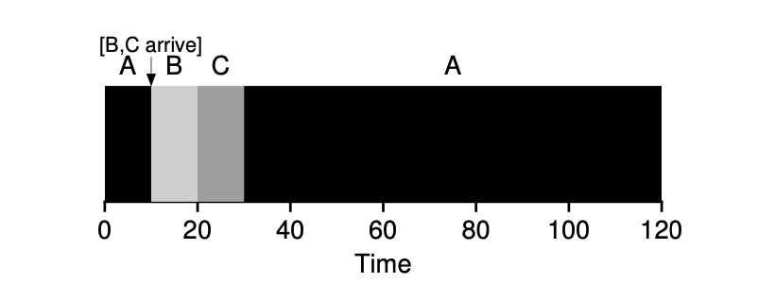
Shortest Remaining Time First (SRTF)
Execution time of A = 100, B = 10, C =10 seconds
A will be preempted when jobs B and C arrive
Average Turn Around Time = 50 seconds
OSTEP Book

Slide 43
Lecture Summary
Scheduling is very important aspect of overall computing system design
Preemptive vs non-preemptive scheduling algorithm
Scheduling algorithms differ from system to system
Batch System
Interactive System
Real-time System
We have studied the following scheduling algorithms for Batch Systems
First Come First Served
Shortest Job First
Shortest Remaining Time First

Slide 44
Assumptions (Unrealistic)
Each job runs for the same amount of time
All jobs arrive at the same time
We will explicitly mention in case jobs don’t arrive at the same time
Once started, each job runs to completion
All jobs only use the CPU (i.e., they perform no I/O)
The run-time of each job is known.

